Slide 1
THIS INSTRUCTION SHEET IS NOT TO BE SHOWN TO, COPIED FOR OR DISTRIBUTED TO EXTERNAL PARTIES
Instructions for Use:
Representative Education Only
This material is approved for Representative Education only.
This material must not be shown to, copied for,
distributed to, discussed with or otherwise used with any external parties
Material Name:
US-ONCA-200029 AML Disease State Essentials Module
Intended Sales Representative Audience (e.g., IMHC, Sales Reps, GPAEs):
Oncology Account Executives, Oncology Senior Managers, Oncology Nurses, Sales Representatives, Internal Stakeholders, and Internal Use
Objective/Need for Representative Education:
Educate on the AML disease state and available treatment options
Clinical or Educational Rationale supporting Objective/Need:
This is a condensed version of the previously approved AML modules: Overview of AML (US-VNCAML-180019), Biology of AML (US-VNCAML-180093), Diagnosis, Classification, and Prognosis of AML – Part 1 and 2 (US-VNCAML-180123 and US-VNCAML-180126).
This module is part of the IFTC curriculum and describes the AML disease state. Topics range from the fundamentals of AML biology to diagnosis and prognosis of the disease.
Key Educational Message(s):
Provides foundational disease state knowledge to build a basic understanding of AML and the patient journey
Other corresponding Representative Education approved materials:
None
Future Plans for further Representative Education:
Treatment of AML Module
Guardrails for Use:
The accompanying information is being provided for representative education purposes only. This information must not be used with any external customer.
Page 1 of 1 ©2020 AbbVie Inc. North Chicago, IL 60064 US-ONCA-200029 May 2020 Produced in U.S.A Version 2.0
FOR REPRESENTATIVE EDUCATION ONLY

Slide 2
AML Disease State Essentials
Module
Notes:
Narration:
Welcome to the Introduction to AML interactive learning experience.
In this module, you will learn the essential AML disease state background, from the biology underlying the disease to the approaches for diagnosis and classification. You’ll learn about who is most likely to develop this disease and the prognosis for patients.
Remember, the information within this module is for your education only.

Slide 3
At-a-glance Overview
Acute myeloid leukemia (AML) is a cancer that begins in the myeloid stem cells of the bone marrow and can eventually spread to the blood and other organs. In 2016, approximately 61,048 people were living with AML in the US, and in 2017, the estimated worldwide incidence was 140,000. The disease is associated with mostly older adults, with a median age of 68 years at diagnosis.
The key characteristics of AML are described in its name:
Acute: rapidly progressing
Myeloid: originates in myeloid stem cells
Leukemia: manifests in the blood and bone marrow
AML is a heterogenous disease with many genetic abnormalities that can occur in the myeloid stem cells, which can also be referred to as leukemic blasts. These genetic abnormalities influence most aspects of the treatment journey for AML patient, from diagnosis to prognosis and treatment options.
In this module, we will explore AML, including the pathogenesis, presentation, diagnosis, and the impact of the disease on patient lives.
Throughout this module you will have the opportunity to hear the patient perspective from a fictional AML patient. When you see a button like the one here, tap to hear from the patient.
Tap here to check in with Rodney
Notes:
Narration:
Acute myeloid leukemia, or AML, is an aggressive cancer that originates in a particular type of blood cell called a myeloid cell. AML is a rare cancer that is primarily diagnosed in older adults.
Many genetic abnormalities can occur in the leukemic blasts of AML and they often influence many aspects of the AML treatment journey, including diagnosis, prognosis, and treatment options.
In this module, we will explore the AML disease state, including pathogenesis, diagnosis, classification, prognosis, and the impact of this disease on patient lives.
Throughout this module you will have the opportunity to learn about the patient experience from Rodney, a fictitious AML patient. Tap the button and take a moment to find out what he has to say.

Slide 4

Meet Rodney
Hi, my name’s Rodney. I’m a 69-year-old retired lawyer, and I was diagnosed with AML a few weeks ago. Did you know that AML develops quickly, and patients can often be unaware that they have such a serious condition?
I was blindsided with my diagnosis and overwhelmed with everything that has happened in the short amount of time since. My AML experience has been a challenge for me and my family, and I look forward to sharing my personal insights and experiences with this disease throughout the course of this module.

Slide 5

Learning Objectives
After completing this module you should be able to:
Describe the typical patients who may be diagnosed with AML
Identify the cells involved in AML and explain the pathogenesis of the disease
List the signs and symptoms of AML
Discuss how AML is diagnosed and classified
Outline the prognostic factors for patients with AML
Recognize how HCPs determine whether a patient is eligible for intensive treatment
AML
Notes:
Narration:
This module is designed to build a strong foundation of knowledge about the AML disease state. Take a moment to read the learning objectives for this module.

Slide 6
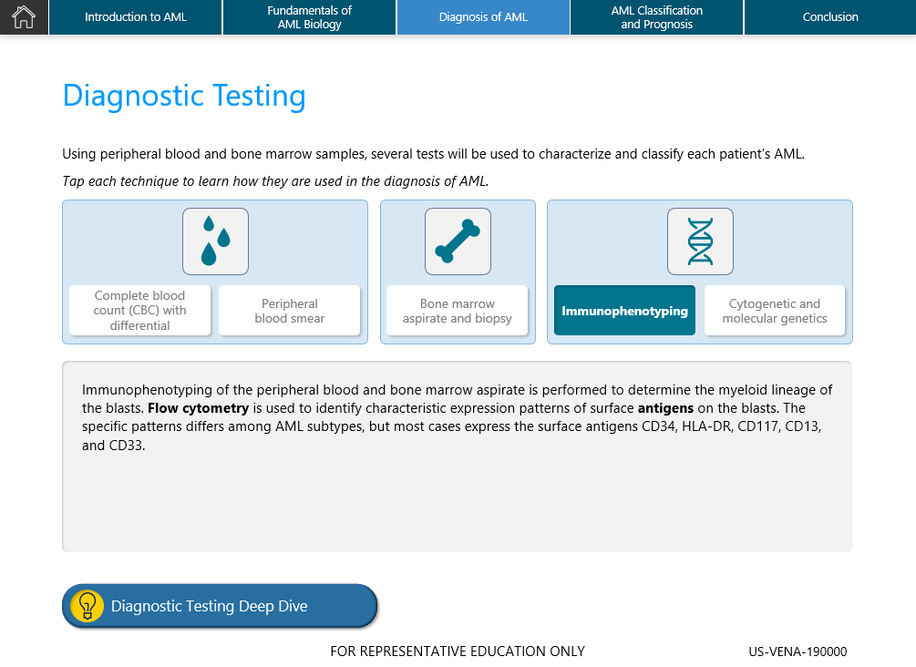
Navigation
1
Navigational features make it simple to move between the sections of this module. Review the features listed here to ensure a seamless learning experience!
The navigation bar displays the chapters within the module and highlights your current position. Tap to quickly navigate to a desired chapter
Terms in bold font are defined in the glossary
2
This icon indicates contextual information related to a topic that is helpful, but not essential.
Notes:
Narration:
Before we dive into the module, familiarize yourself with the navigational features of the AML Foundations interactive modules.

Slide 7


Chapter 1 Introduction to AML
AML is the most common acute leukemia in adults. This chapter introduces the AML disease state and describes who is affected by this disease. Over the course of this module, we’ll dive deeper into the development of AML and investigate how it’s diagnosed and classified.
After completing this chapter, you will be able to:
Define AML
Identify the cell type affected by AML
List risk factors associated with AML
Describe the typical patients who may be diagnosed with AML
What is AML?
Epidemiology
Notes:
Narration:
AML is the most common acute leukemia in adults. In this chapter we’ll introduce the AML disease state and describe who is affected by the disease.
Before we continue, take a moment to review the key learning objectives for this chapter.

Slide 8
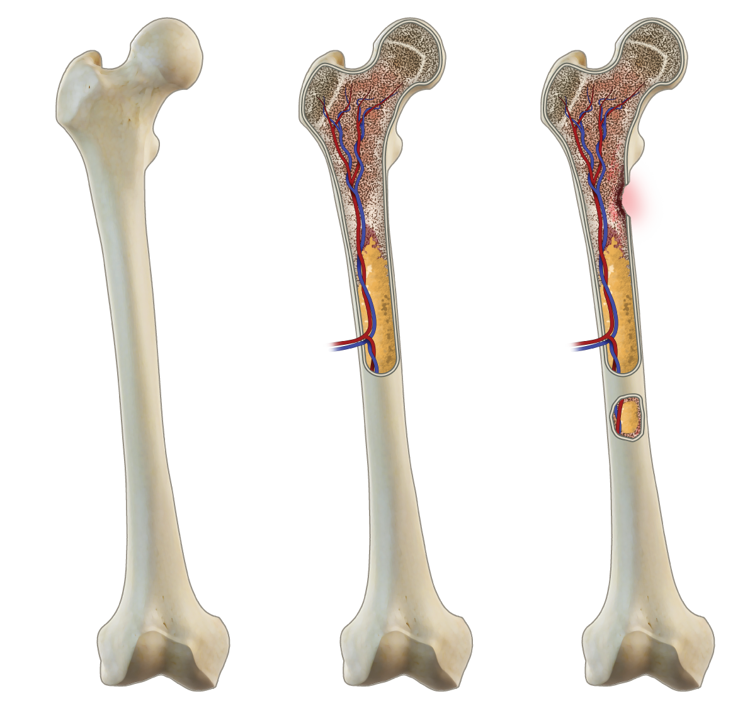
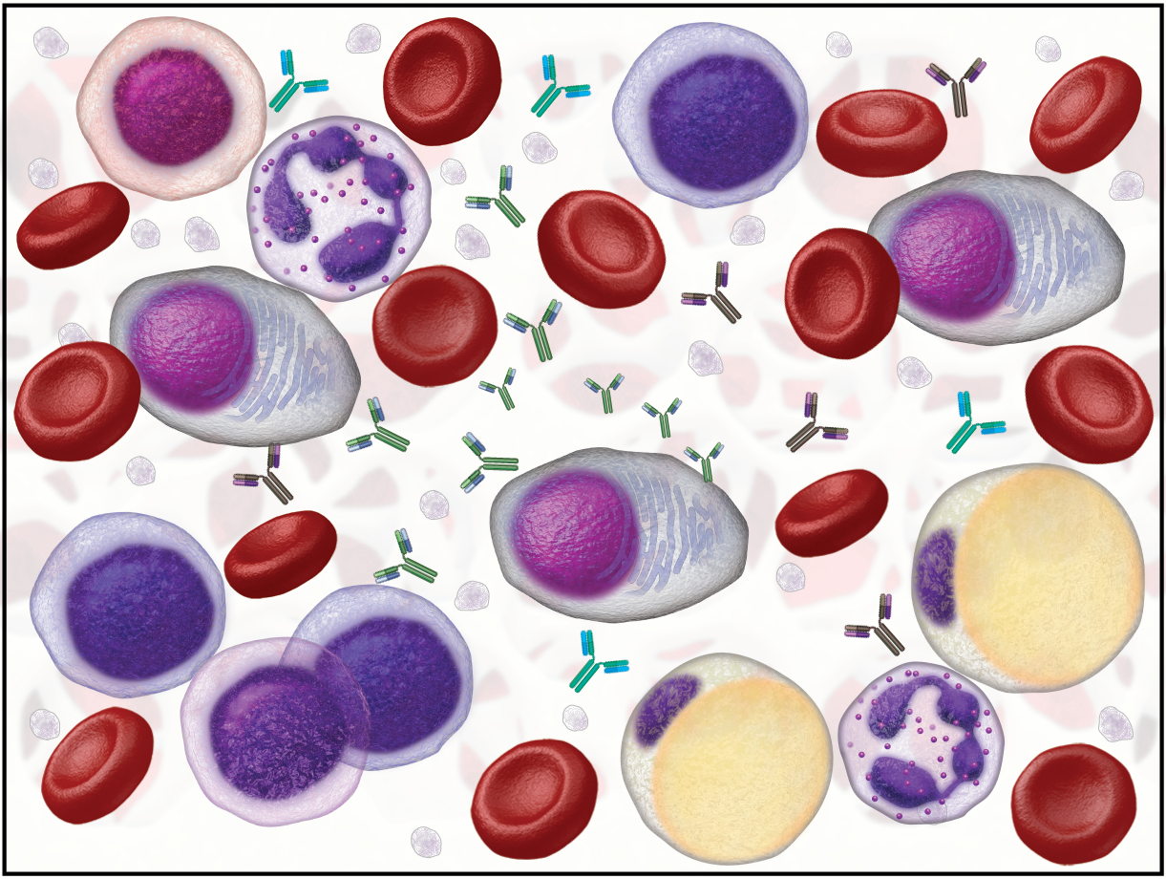
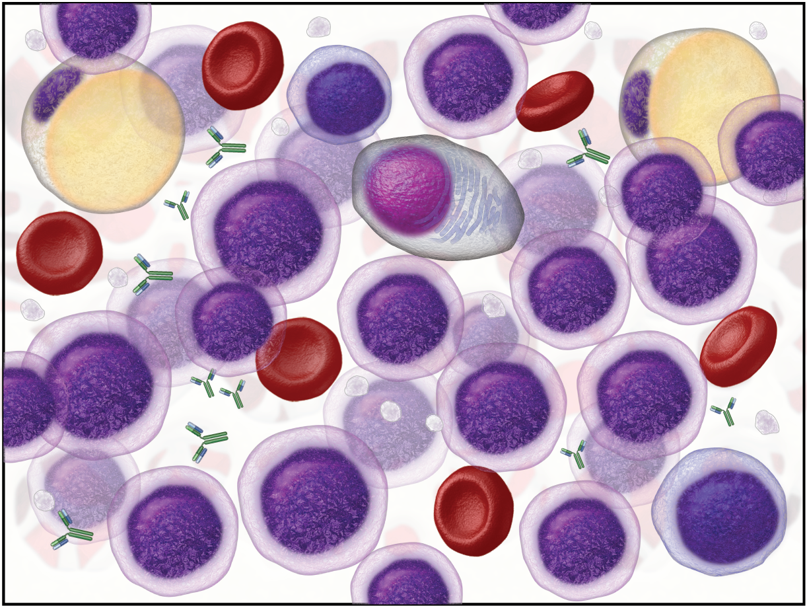

What is AML?
AML is a rapidly growing and aggressive cancer that starts in immature myeloid blood cells in the bone marrow. Normally, myeloid stem cells differentiate and mature to become functional blood cells—including red blood cells (RBCs), white blood cells (WBCs), and platelets—that support the body.
In AML, the rapid proliferation and build up of clonal myeloid blasts in the bone marrow, peripheral blood, and/or other tissues prevents the normal production of RBCs, WBCs, and platelets.
Minimal myeloid blasts
Normal bone marrow
Buildup of myeloid blasts
AML bone marrow
Types of Leukemia
Genetic mutations in the DNA of blasts causes them to overcrowd the marrow, which decreases the growth of mature, functional blood cells.
Look AHEAD
Since AML limits the production of mature, functional blood cells (RBCs, WBCs, and platelets), symptoms of AML are generally a result of low blood counts. Chapter 3 will discuss this in more detail.
Notes:
Narration:
AML is an aggressive cancer that begins in immature myeloid cells located in the bone marrow. These cells typically mature to become functional blood cells, but in AML, the build up of clonal myeloid blasts in the bone marrow prevents the normal production of red blood cells, white blood cells, and platelets.
Tap the button to learn more about the different types of leukemia.

Slide 9
Types of Leukemia
Leukemia can be subdivided into 4 main types: acute myelogenous leukemia (AML), acute lymphocytic leukemia (ALL), chronic myelogenous leukemia (CML), and chronic lymphocytic leukemia (CLL). While these names may seem overwhelming at first glance, each type of leukemia is classified based on the speed of its progression and the origin of the WBC it affects. For instance, leukemias can be classified as either acute or chronic, as well as lymphocytic or myelogenous.
Progression
Acute—Acute leukemias progress at a rapid rate. They are caused by mutations in immature blast cells, which multiply rapidly, causing the accelerated progression of the disease
Chronic—Chronic leukemias generally progress slowly. They are caused by mutations in more mature WBCs that divide and accumulate at a slower rate compared to acute leukemias. These cells may also be able to function normally for a period of time, which may allow chronic leukemias to go unnoticed for years
Cell Origin
Lymphocytic—Lymphocytic leukemias involve the lymphoid cells, or lymphocytes (eg, B cells, T cells, natural killer cells)
Myelogenous—Myelogenous leukemias affect the myeloid cells, which give rise to RBCs, WBCs, and platelets
Look Back
The Introduction to Oncology and Cancer Cell Biology module provides an overview of the differences between lymphoma, leukemia, and other types of cancer.
Notes:
Narration:
Leukemia can be classified into 4 main types based on the speed of its progression and the origin of the white blood cell it affects.
Read more to discover the similarities and differences of AML with other leukemias.

Slide 10
AML Epidemiology
AML is the most common acute leukemia in adults, and the average lifetime risk of developing AML is about 0.5%. In the US, leukemia accounts for 3.5% of all new cancer cases, and AML accounts for 1.2%. While the death rates have remained stable from 2007–2016, the rates of new cases have been rising on average 2.0% each year over the last 10 years. In fact, the 5-year survival rate for AML is 28.3%.
Estimated New Cases
Estimated
Deaths
Relative Frequency of Leukemia Subtypes
2019 US Statistics
21,450
10,920
Men
Women
Incidence in US
Per 100,000
4.3 cases
4.3
cases
5-year Survival Rate
28.3%
AML=acute myeloid leukemia; ALL=acute lymphocytic leukemia; CML=chronic myeloid leukemia; CLL=chronic lymphocytic leukemia
Tap here to check in with Rodney
Notes:
Narration:
Although AML is the most common acute leukemia in adults, it accounts for 1.2% of all new cancer cases in the United States and has a 5-year survival rate of 28.3%.
Review the events estimated to occur in 2019 here, and to learn more about Rodney’s experience, tap the button.

Slide 11
Rodney the AML Patient
Although AML is the most common form of acute leukemia, it is overall a rare form of cancer. Since I was diagnosed very recently, I haven’t had the chance to meet many other patients, but after researching my disease online, I’ve found some quick facts. I’m around the typical age of most patients when they are diagnosed with AML. In fact, the majority of AML patients are over the age of 60.

Slide 12
Who Is Affected by AML?
Although AML can occur at any age, adults age 60 years or older are more likely to develop the disease than younger people. It is most frequently diagnosed among people aged 65–74, with the median age at diagnosis being 68 years. In addition, death rates from AML are higher among adults 65 years and older, and the median age at death is 72 years. Older patients tend to have a worse outcome since they cannot tolerate the intense treatment regimens and symptoms of the disease.
Tap to see the patient demographics based on age.
SELECTED Risk Factors
Age: The risk of AML increases as people age. The risk of developing AML increases ~8-fold from ages 30–34 years to ages 65–69 years
Previous chemotherapy or radiation therapy: People exposed to cytotoxic agents or radiation therapy are at increased risk of developing AML or a myeloid neoplasm
History of a blood disorder: Pre-existing myelodysplastic or myeloproliferative disorders are common in older patients with AML
Genetic disorders: Certain genetic conditions present at birth, such as Down syndrome, increase the risk of developing AML
New Cases
Deaths
25.1%
22.7%
16.8%
Percentage of New Cases
9.1%
11.0%
4.5%
5.7%
5.3%
Age
Median Age at Diagnosis
68
Notes:
Narration:
One risk factor for developing AML is age. The risk of developing AML increases approximately 8-fold from ages 30–34 years to ages 65–69 years. The median age at diagnosis for AML is 68 years.
Review the remaining risk factors associated with the diagnosis of AML. After, tap the buttons to view patient demographic data based on age.

Slide 13
Who Is Affected by AML?
Although AML can occur at any age, adults age 60 years or older are more likely to develop the disease than younger people. It is most frequently diagnosed among people aged 65–74, with the median age at diagnosis being 68 years. In addition, death rates from AML are higher among adults 65 years and older, and the median age at death is 72 years. Older patients tend to have a worse outcome since they cannot tolerate the intense treatment regimens and symptoms of the disease.
Tap to see the patient demographics based on age.
SELECTED Risk Factors
Age: The risk of AML increases as people age. The risk of developing AML increases ~8-fold from ages 30–34 years to ages 65–69 years
Previous chemotherapy or radiation therapy: People exposed to cytotoxic agents or radiation therapy are at increased risk of developing AML or a myeloid neoplasm
History of a blood disorder: Pre-existing myelodysplastic or myeloproliferative disorders are common in older patients with AML
Genetic disorders: Certain genetic conditions present at birth, such as Down syndrome, increase the risk of developing AML
New Cases
Deaths
27.7%
29.5%
Percentage of Deaths
15.2%
14.2%
6.3%
1.8%
2.5%
2.7%
Age
Median Age at Death
72

Slide 14




AML Patient Journey
For all cancers, the patient journey is emotionally and physically challenging. The patient experience in AML is particularly difficult because of the speed at which the disease develops and progresses. Patients are often blindsided with their diagnosis and are easily overwhelmed with the decisions that need to be made quickly in order to treat the disease appropriately.
AML progresses rapidly and should be treated quickly and appropriately. Chemotherapy is the main treatment option for AML patients. Since AML is a disease of older adults, not all patients are healthy enough to handle the intense chemotherapy agents needed to kill the leukemic cells. Treatment strategies are stratified into 2 categories based largely on the patient’s age—eligible for intensive chemotherapy and ineligible for intensive chemotherapy. However, additional factors, such as fitness and mutational status, can influence whether a patient is considered to be eligible for intensive chemotherapy.
Eligible for Intensive Chemotherapy
Ineligible for Intensive Chemotherapy
Patients who are typically younger (<60 years old, although different HCPs will define this patient subset in variable ways).
Patients who are typically older (≥60 years old) and/or have comorbidities and sometimes younger patients with severe comorbidities.
Notes:
Narration:
AML can be a particularly challenging disease for patients because of the speed at which it develops and progresses.
Treatment of AML should be aggressive and begin shortly after diagnosis. The main treatment option for AML is chemotherapy and patients are categorized into 2 groups largely based on their age: patients who are <60 years old are considered eligible for intensive chemotherapy and patients who are ≥60 years old are considered ineligible for intensive chemotherapy.
This module will not discuss the treatment of AML further, but this distinction is critical for your understanding of how clinicians approach AML and how the AML patient journey differs among patient types.

Slide 15
Chapter Summary
AML is a rapidly growing cancer that affects immature myeloid cells. It begins in the bone marrow but can spread to the peripheral blood and rarely other organs, including lymph nodes, liver, and spleen
AML is the most common acute leukemia in adults—median age at diagnosis is 68
Older AML patients tend to have a worse outcome as they usually cannot tolerate the intensive chemotherapy needed to destroy the leukemic cells
Notes:
Narration:
In this chapter we introduced the AML disease state and described the typical patient characteristics using epidemiology.
Review the key concepts we discussed from Chapter 1 here.

Slide 16
What type of blood cell is affected in AML?
Immature myeloid cells
or
Immature lymphoid cells
Notes:
Remediation after answering:
Correct/incorrect. Immature myeloid cells are affected in AML.

Slide 17
From the word bank below, drag and drop the risk factors associated with the development of AML into the box.
Risk Factors
Age
Previous chemotherapy or radiation therapy
History of a blood disorder
Gender
Genetic disorders
Fitness
Diet
Race/ethnicity
Word Bank
Cardiovascular disease
Notes:
Remediation after answering:
Correct/incorrect. Age, previous chemotherapy or radiation therapy, history of a blood disorder, gender, and genetic disorders are all risk factors for developing AML.

Slide 18
What is the median age at diagnosis of an AML patient?
A. 49 years
B. 56 years
C. 68 years
D. 72 years
Notes:
Remediation after answering:
Correct/incorrect. The median age at diagnosis of an AML patient is 68 years.

Slide 19
Chapter 2 Fundamentals of AML Biology
To better understand the AML disease state, it is important to know the basics of myeloid stem cell biology. This chapter explains the differentiation process of myeloid stem cells, the development of AML, and the AML genetic landscape.
After completing this chapter, you will be able to:
Outline the steps of myeloid stem cell maturation
Describe how AML develops
Identify the common genetic abnormalities that occur in the DNA of AML blasts
Myeloid Stem Cell Biology
Development of AML
Genetic Landscape
Notes:
Narration:
To better understand the AML disease state, it’s important to understand the basics of myeloid cell biology. In this chapter, we’ll discuss the differentiation process of myeloid stem cells, the development of AML, and the AML genetic landscape.
Before we continue, take a moment to review the key learning objectives for this chapter.

Slide 20

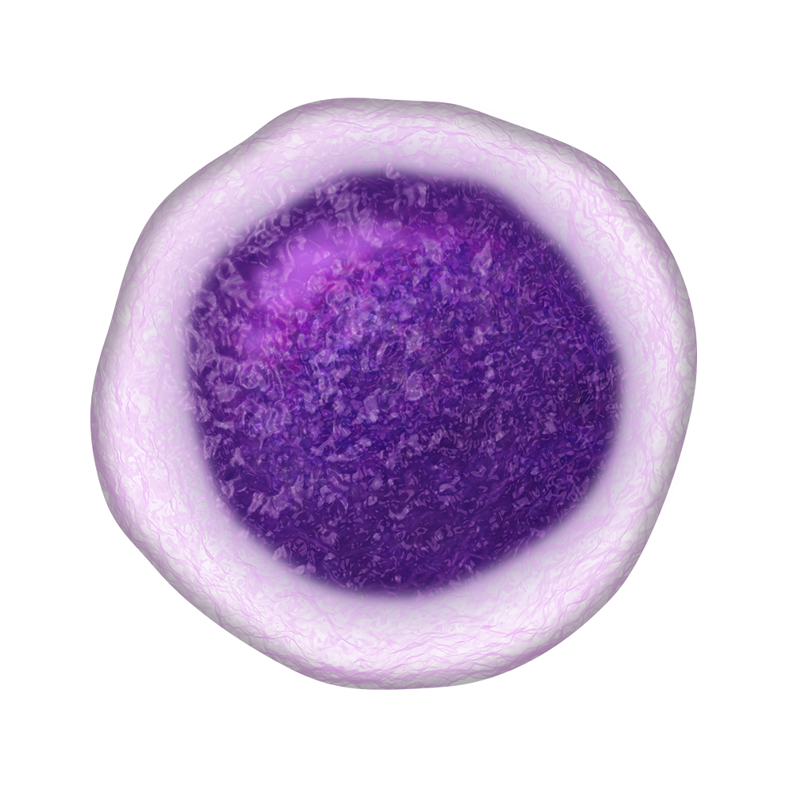
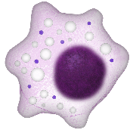

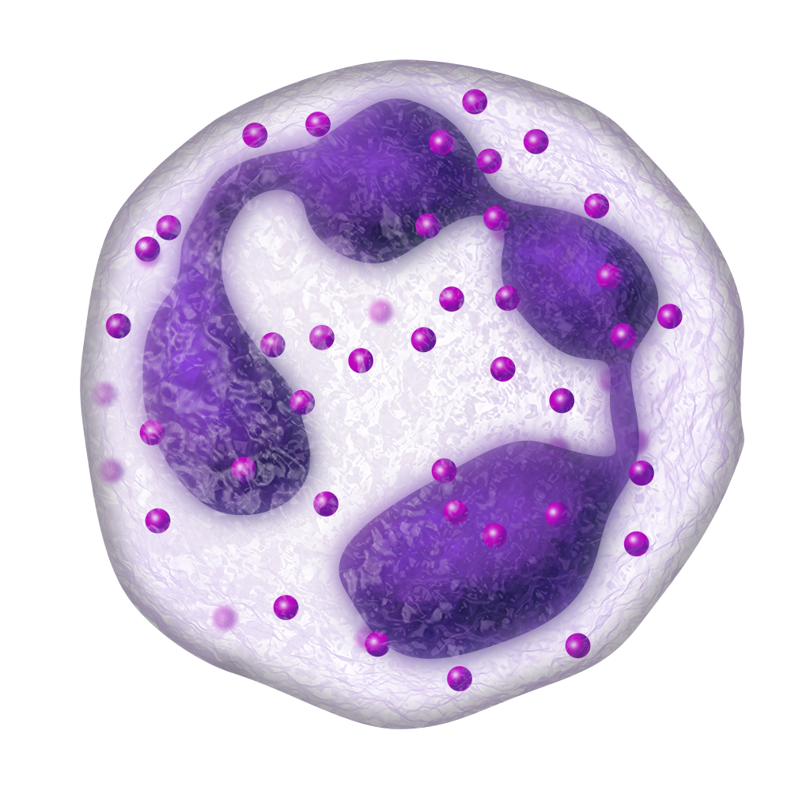
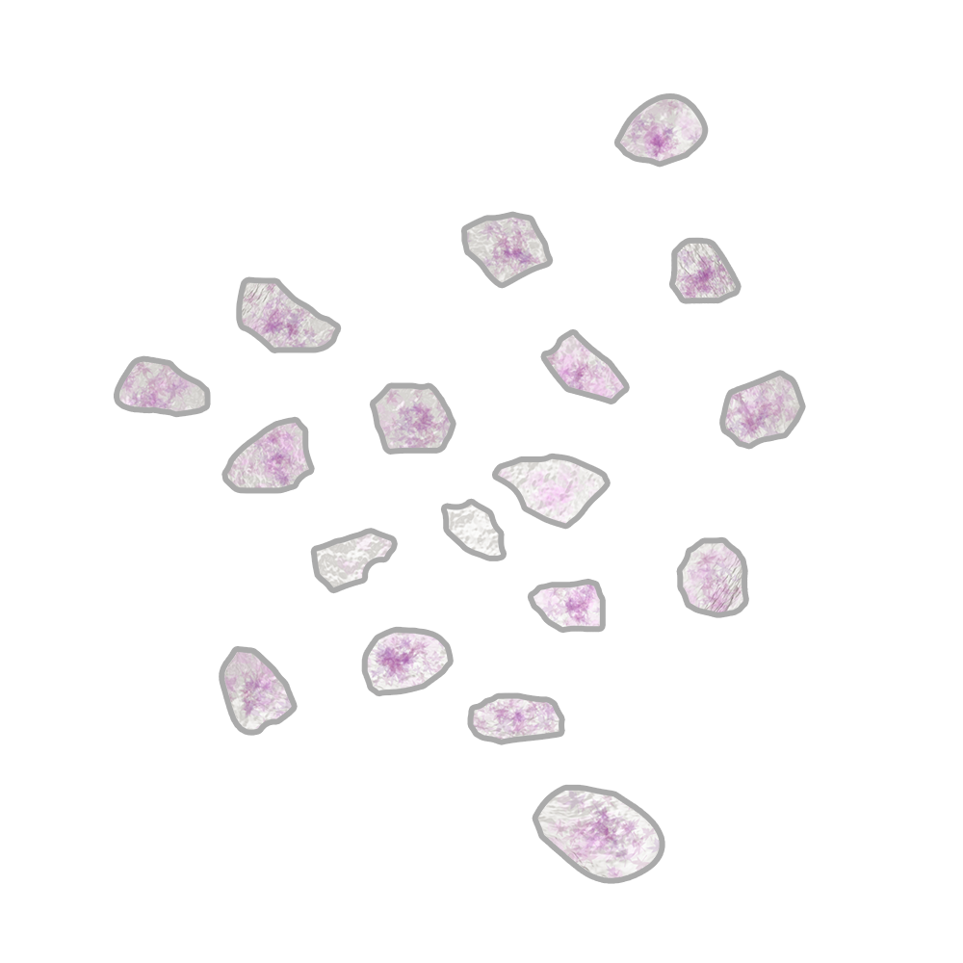
Hematopoiesis and Hematopoietic Stem Cells
Blood cells are formed through a constant and ongoing process called hematopoiesis. It is estimated that healthy adults produce 10 billion RBCs and 1 billion WBCs every hour. In adults, hematopoiesis occurs in the red (active) bone marrow of the skull, spine, pelvis, and ends of the long bones.
Hematopoiesis starts with hematopoietic stem cells (HSCs), which originate in the bone marrow. Here, HSCs can undergo self-renewal, which enables them to replicate and form clones of the original cell. These cells can either remain pluripotent or undergo differentiation and develop into mature, functional blood cells—including RBCs, WBCs, and platelets.
Red bone marrow
Red blood cells
Hematopoietic stem cells
White blood cells
Platelets
Hematopoiesis is the formation of new, mature blood cells from hematopoietic stem cells.
Notes:
Narration:
Hematopoiesis is the process by which new blood cells are formed. In adults, it occurs in the bone marrow of the skull, spine, pelvis, and ends of the long bones.
Hematopoiesis begins with the maturation and development of hematopoietic stem cells into mature, functional blood cells, such as red blood cells, white blood cells, and platelets.

Slide 21




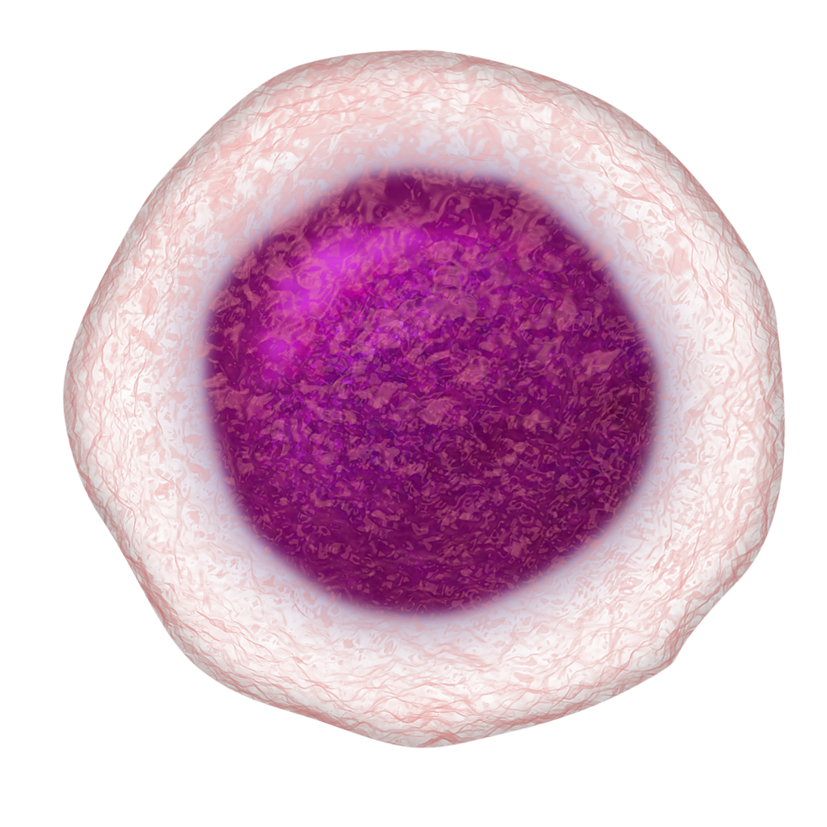
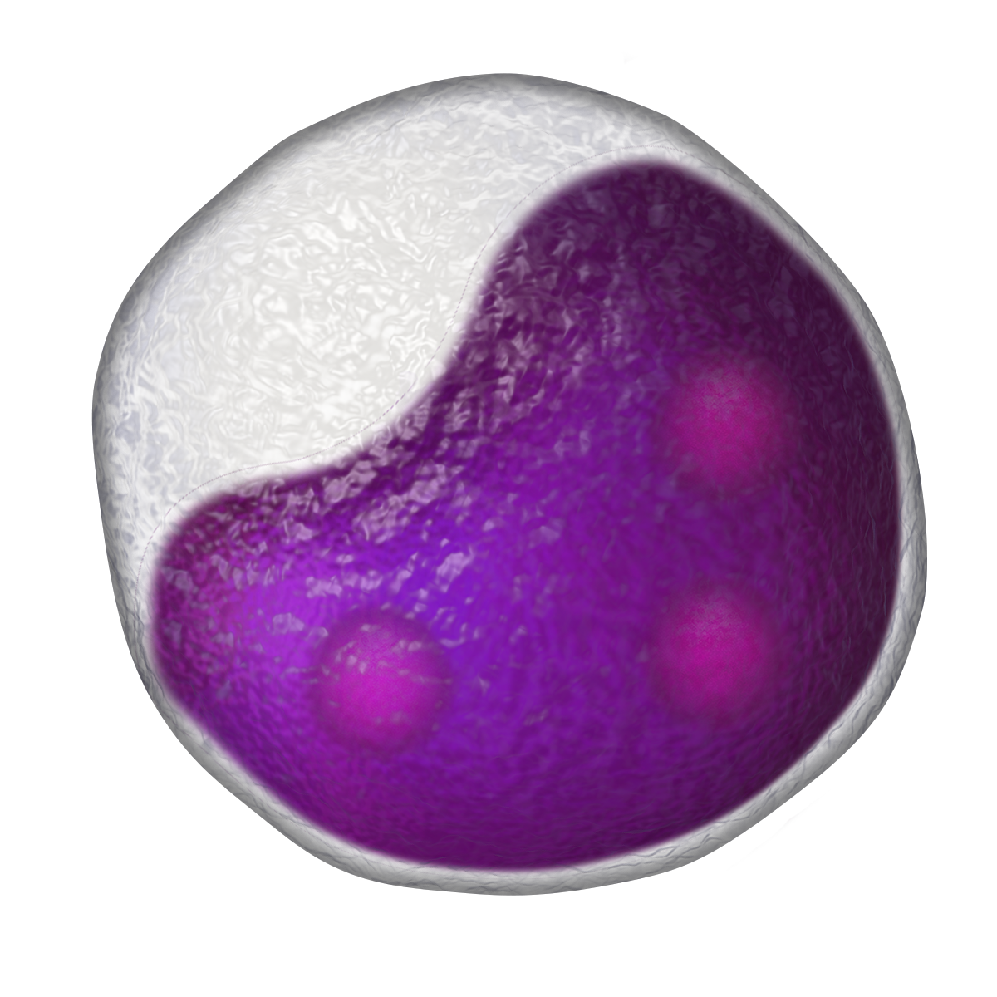
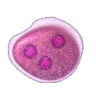

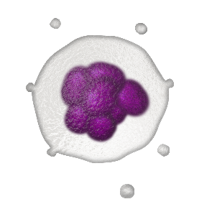



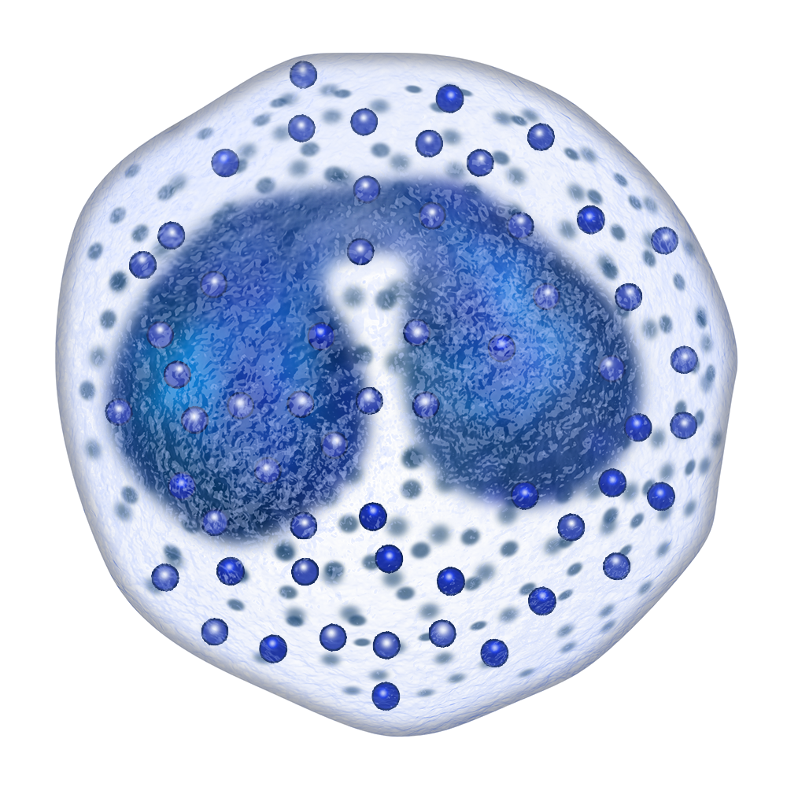
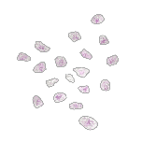

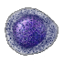



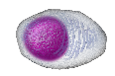
Myeloid Stem Cell Maturation and Lineage
In the first step of maturation, hematopoietic stem cells can develop along either of 2 different pathways—the myeloid or lymphoid lineage—to become either common myeloid or lymphoid progenitor cells. At this point, the progenitor cells are committed to the specific lineage and can further differentiate through various pathways. Each pathway ultimately leads to the formation of a specific type of blood cell such as a RBC, WBC, or platelet.
Tap on the cells to build the lineage of hematopoietic cells that develop into the various blood cell types.
Replication and self-renewal
Hematopoietic stem cell
Common myeloid progenitor
Common lymphoid progenitor
Megakaryoblast
Proerythroblast
Monoblast
Myeloblast
Lymphoblast
Natural killer cell
Megakaryoblast
Reticulocyte
T lymphocyte
B lymphocyte
Platelets
Red blood cells
Mast cell
Monocyte
Granulocytes
Plasma cell
Notes:
Narration:
Hematopoietic stem cells mature and develop along 2 different pathways: the myeloid or lymphoid lineage to become progenitor cells of each lineage.
The progenitor cells are committed to their lineage and will further develop to form specific types of blood cell.
Tap on the cells to build the various lineages of hematopoietic cells.

Slide 22
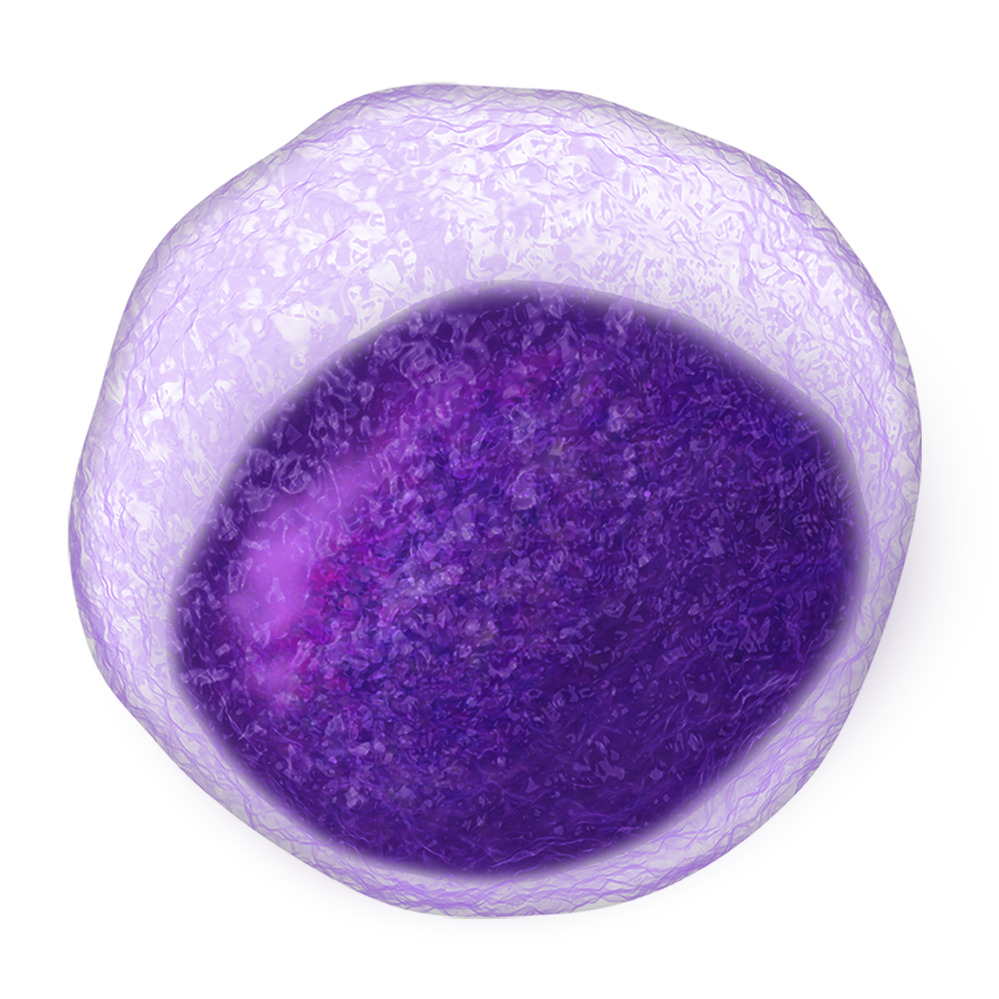

Pathogenesis of AML
AML develops as the result of a series of genetic changes in immature myeloid cells. These changes alter the normal growth and differentiation of the cells, causing an accumulation of large numbers of abnormal, immature myeloid cells, or blasts, in the bone marrow and peripheral blood. These cells are capable of dividing and proliferating, but cannot differentiate into mature, functional blood cells.
AML is a clonal process that develops from a single transformed myeloid blast. The myeloid blasts can be in various stages of maturation when they transform into malignant leukemic cells, making AML a heterogeneous disease affecting different myeloid blast lineages.
The build up of blasts in the bone marrow ultimately prevents the normal production of mature, functional blood cells to support the body. The signs and symptoms of AML are most often due to the presence of blasts and the absence of mature RBCs, WBCs, and platelets.
Potential origin cells for AML
Hematopoietic stem cell
Common myeloid
progenitor
Megakaryoblast
Proerythroblast
Monoblast
Myeloblast
Megakaryocyte
Reticulocyte
Thrombocytes
(Platelets)
Erythrocytes
(RBCs)
Mast cell
Monocyte
Granulocytes
(WBCs)
Notes:
Narration:
AML occurs because of genetic changes in immature myeloid cells. These changes alter the cells ability to mature into functional blood cells and instead, they rapidly grow and accumulate in the bone marrow and peripheral blood.
The immature myeloid cells, or blasts, can be in various stages of maturation when they transform into leukemic cells, which makes AML a heterogeneous disease affecting different myeloid blast lineages.

Slide 23
Development of AML—De Novo vs Secondary
Genetic changes in myeloid blasts causes AML to develop. These changes can occur through various processes, and AML can be split into 2 categories based on how it develops—de novo AML and secondary AML.
Tap each category to learn how the different types of AML develop.
De Novo AML
Secondary AML
De novo AML refers to AML in patients who do not have a history of myelodysplastic syndrome or blood disorder and have not had previous treatment with cytotoxic chemotherapy agents or ionizing radiation.
Although environmental and hereditary risk factors have been identified, the majority of patients with de novo AML do not have these risk factors, and the etiologic factors contributing to the development of their AML remains unknown.
Notes:
Narration:
AML can be split into 2 categories based on how it develops—de novo AML and secondary AML.
Tap on the categories to review how each type of AML develops.

Slide 24
Development of AML—De Novo vs Secondary
Genetic changes in myeloid blasts causes AML to develop. These changes can occur through various processes, and AML can be split into 2 categories based on how it develops—de novo AML and secondary AML.
Tap each category to learn how the different types of AML develop.
De Novo AML
Secondary AML
Secondary AML refers to AML that has developed due to:
Previous cancer treatment (eg, cytotoxic chemotherapy or radiation therapy). This type of AML is known as therapy-related myeloid neoplasm (tMN)
Previous hematologic malignancy (myelodysplastic syndrome). This type of AML is known as AML with myelodysplasia-related changes
Secondary AML accounts for approximately 25% of all AML cases and is associated with poor outcomes.

Slide 25
AML Genomic Landscape
AML is a heterogeneous disease with a large number of potential causative genetic mutations. Mutations in the DNA of myeloid blasts can range from chromosomal abnormalities to specific gene mutations. Many chromosomal and genetic abnormalities can influence prognosis and treatment strategies, and it is important for HCPs to determine each patient’s cytogenetic and molecular genetic abnormalities during diagnosis.
Notes:
Narration:
Chromosomal abnormalities and specific gene mutations can occur in the DNA of myeloid blasts, causing the development of AML. Now let’s explore several of the chromosomal and genetic abnormalities and how they can influence a patient’s prognosis and treatment options.

Slide 26
Cytogenetic Abnormalities in AML
Cytogenetic abnormalities or large-scale chromosomal changes can be detected in approximately 50% of newly-diagnosed AML patients. Many different cytogenetic abnormalities exist in AML, some are more common than others. Chromosomal abnormalities are detected using a karyotype test, which is a type of image of the chromosomes in a leukemic cell. Karyotype results are significant to prognosis and treatment decisions and represent the most important factor for predicting a patient’s outcome.
Understanding Cytogenetic Notation
Notes:
Narration:
Approximately 50% of newly-diagnosed AML patients have a detectable chromosomal abnormality. The more commonly observed abnormalities are incorporated in the AML classification systems, which we will review later in the module.
Tap the button to refresh your knowledge of cytogenetic notation.

Slide 27
Understanding Cytogenetic Notation
Humans have 46 chromosomes organized as 23 chromosome pairs. An individual chromosome is divided into 2 arms: the short arm and the long arm. The short arm is designated p (for petit), and the long arm is designated q (for queue).
p
q
In many instances chromosomal mutations are written using an abbreviated code. The code begins with the type of mutation, followed by the affected chromosome(s), and ends with the chromosome arm (if only part of the chromosome is affected). Specific examples of abbreviations you may frequently encounter are shown below.
Long arm of chromosome 21 at band 22.1
Long arm of chromosome 16 at band 22
Translocation
t(8;21)(q22;q22.1)
Inversion
inv(16)(p13.1q22)
Long arm of chromosome 8 at band 22
Short arm of chromosome 16
at band 13.1
Notes:
Narration:
Human chromosomes are divided into 2 arms: the short arm and the long arm. Read more to learn how to decipher the code used to describe the type chromosomal mutation and where it occurs.

Slide 28
Molecular Genetic Abnormalities in AML
Molecular genetics examines the mutation of specific genes in AML cells. Advances in technology have led to the discovery of several mutations that have a prognostic impact on patients. Several genes, such as IDH1/2 and FLT3, are actionable mutations with approved therapy options. Therefore, molecular genetic testing has become a standard part of every patient’s diagnostic work-up and can influence treatment options.
Tap each of the gene mutations to learn more.
IDH1/2
FLT3
TP53
NPM1
IDH1/2
Mutation in the genes encoding the isocitrate dehydrogenase (IDH) enzymes that catalyze the conversion of isocitrate to α-ketoglutarate, a metabolite that blocks cell differentiation
Found in approximately 7% (IDH1) and 9% (IDH2) of AML patients
No consensus on prognostic impact
Additional Gene Mutations
Notes:
Narration:
Molecular genetic testing for specific genes in AML cells has become a standard part of the AML diagnostic work-up. The commonly mutated genes can be classified into functional categories that are believed to play a role in the development of AML.
Tap each gene mutation and the button at the bottom to learn more.

Slide 29
Molecular Genetic Abnormalities in AML
Molecular genetics examines the mutation of specific genes in AML cells. Advances in technology have led to the discovery of several mutations that have a prognostic impact on patients. Several genes, such as IDH1/2 and FLT3, are actionable mutations with approved therapy options. Therefore, molecular genetic testing has become a standard part of every patient’s diagnostic work-up and can influence treatment options.
Tap each of the gene mutations to learn more.
IDH1/2
FLT3
TP53
NPM1
FLT3
Mutation in the gene encoding a transmembrane tyrosine kinase receptor that stimulates cell proliferation upon activation
Two main types of mutations—internal tandem duplications (ITD) of different lengths and point mutations in the kinase domain (TKD)
FLT3-ITD mutations occur in approximately 30% of adult patients with cytogenetically normal AML, and FLT3-TKD mutations occur in 5–10% of patients
FLT3-ITD mutation is associated with a poor prognosis, however the prognosis of FLT3-TKD mutation is unclear
Additional Gene Mutations

Slide 30
Molecular Genetic Abnormalities in AML
Molecular genetics examines the mutation of specific genes in AML cells. Advances in technology have led to the discovery of several mutations that have a prognostic impact on patients. Several genes, such as IDH1/2 and FLT3, are actionable mutations with approved therapy options. Therefore, molecular genetic testing has become a standard part of every patient’s diagnostic work-up and can influence treatment options.
Tap each of the gene mutations to learn more.
IDH1/2
FLT3
TP53
NPM1
TP53
Mutation in the gene encoding tumor protein 53, which has a role in regulating cell division
Found in approximately 7% of AML patients, although the incidence may be higher in patients with AML that evolved from a prior myelodysplastic syndrome
Associated with poor prognosis and patients with TP53 mutation and complex karyotype have even worse prognosis
Additional Gene Mutations

Slide 31
Molecular Genetic Abnormalities in AML
Molecular genetics examines the mutation of specific genes in AML cells. Advances in technology have led to the discovery of several mutations that have a prognostic impact on patients. Several genes, such as IDH1/2 and FLT3, are actionable mutations with approved therapy options. Therefore, molecular genetic testing has become a standard part of every patient’s diagnostic work-up and can influence treatment options.
Tap each of the gene mutations to learn more.
IDH1/2
FLT3
TP53
NPM1
NPM1
Mutation in the nucleophosmin (NPM1) gene impairs the resulting protein’s ability to shuttle from the cytoplasm to the nucleus
Present in approximately 25% of patients with de novo AML and 50% of patients with de novo AML normal karyotype
Associated with improved outcomes in younger and older adults, although concurrent abnormalities in other genes can impact prognosis
Additional Gene Mutations

Slide 32
Additional Gene Mutations
CEBPA
Mutation in the CCAAT/enhancer binding protein alpha (CEBPA) gene that encodes a transcription factor essential for myeloid differentiation
Present in approximately 10% of patients with newly diagnosed AML and 13–19% of patients with cytogenetically normal AML
Associated with improved outcomes, although may be limited to patients with 2 copies of the mutated gene who are also negative for FLT3-ITD and IDH2 R140 mutations
ASXL1
Mutation in additional sex combs-like (ASXL) gene, whose biologic function is unclear
Found in approximately 6–30% of AML patients; incidence increases with age and is higher among those with a history of a myeloid malignancy
Associated with poor prognosis
Notes:
Narration:
Read more to discover additional gene mutations found in AML blasts.

Slide 33
Chapter Summary
Mature blood cells form through a process called hematopoiesis. HSCs mature and differentiate through either the myeloid or lymphoid pathway to form RBCs, WBCs, and platelets
In AML, immature myeloid blasts quickly accumulate in the blood and bone marrow, causing disease. This accumulation is due to genetic mutations in the DNA of blasts that affect their growth and differentiation
AML is a heterogeneous disease with numerous chromosomal and genetic mutations that can occur. Chromosomal and genetic abnormalities are common in patients and can be powerful prognostic factors
Notes:
Narration:
In this chapter we discussed the growth of blood cells and the genetic abnormalities that can lead to the development of AML.
Review the key concepts we discussed from Chapter 2 here.

Slide 34
Myeloid progenitor cells can develop into which of the following mature blood cell types?
A. RBCs
B. WBCs
C. Platelets
D. All of the above
Notes:
Remediation after answering:
Correct/incorrect. Myeloid progenitor cells can develop into RBCs, WBCs, and platelets.

Slide 35
True or False: AML is a heterogeneous disease with many chromosomal and molecular genetic abnormalities that can influence treatment options.
A. True
B. False
Notes:
Remediation after answering:
Correct/incorrect. True. AML is a heterogeneous disease with many chromosomal and molecular genetic abnormalities that can influence treatment options.

Slide 36
Molecular genetic testing has become a standard part of the AML diagnostic work-up due to the prognostic impact of the mutated genes on patients. Select the commonly mutated genes in AML.
FLT3
TP53
BCR-ABL
BTK
PI3K
IDH1/2
Notes:
Remediation after answering:
Correct/incorrect. FLT3, IDH1/2, and TP53 are all commonly mutated genes in AML.

Slide 37

Chapter 3 Diagnosis of AML
Since AML progresses rapidly, patients often feel unwell for a short period before their diagnosis. This chapter describes the signs and symptoms of the disease and the techniques used for diagnosing AML.
After completing this chapter, you will be able to:
Recall the signs and symptoms of AML
Explain the steps for evaluating the patient’s disease
Identify how AML is diagnosed
Signs and Symptoms
Patient Evaluation
Diagnostic Testing
Notes:
Narration:
Since AML progresses rapidly, patients often feel unwell for a short period of time before their diagnosis. In this chapter we’ll discuss the signs and symptoms of AML and the techniques used to diagnose the disease.
Before we continue, take a moment to review the learning objectives for this chapter.

Slide 38




Signs and Symptoms
Many signs and symptoms of AML occur because there is an overproduction of myeloid blasts and a shortage of healthy blood cells. The resulting low blood counts can lead to signs and symptoms that make patients feel unwell. Since AML progresses quickly, patients often feel ill for a relatively short time before receiving a diagnosis. The signs and symptoms of AML can be non-specific and associated with other diseases, so patients rarely suspect something as severe as cancer. These include:
The underproduction of healthy blood cells can also cause patients to experience specific symptoms related to low blood counts.
Tap each blood cell type to learn the symptoms of low cell counts.
Fatigue
Fever
Night sweats
Weight loss
Loss of appetite
Anemia
low RBCs
Tiredness (fatigue)
Weakness
Feeling cold
Feeling dizzy or lightheaded
Headaches
Pale skin
Shortness of breath
Thrombocytopenia
low platelets
Neutropenia
low neutrophils
Notes:
Narration:
Many signs and symptoms of AML can be attributed to the overproduction of myeloid blasts and shortage of healthy blood cells.
Tap each blood cell type to learn the symptoms of low cell counts.

Slide 39
Signs and Symptoms
Many signs and symptoms of AML occur because there is an overproduction of myeloid blasts and a shortage of healthy blood cells. The resulting low blood counts can lead to signs and symptoms that make patients feel unwell. Since AML progresses quickly, patients often feel ill for a relatively short time before receiving a diagnosis. The signs and symptoms of AML can be non-specific and associated with other diseases, so patients rarely suspect something as severe as cancer. These include:
The underproduction of healthy blood cells can also cause patients to experience specific symptoms related to low blood counts.
Tap each blood cell type to learn the symptoms of low cell counts.
Fatigue
Fever
Night sweats
Weight loss
Loss of appetite
Anemia
low RBCs
Bruises
Petechiae
Excess bleeding
Frequent or severe nosebleeds
Bleeding gums
Heavy menstrual bleeding in women
Thrombocytopenia
low platelets
Neutropenia
low neutrophils

Slide 40
Signs and Symptoms
Many signs and symptoms of AML occur because there is an overproduction of myeloid blasts and a shortage of healthy blood cells. The resulting low blood counts can lead to signs and symptoms that make patients feel unwell. Since AML progresses quickly, patients often feel ill for a relatively short time before receiving a diagnosis. The signs and symptoms of AML can be non-specific and associated with other diseases, so patients rarely suspect something as severe as cancer. These include:
The underproduction of healthy blood cells can also cause patients to experience specific symptoms related to low blood counts.
Tap each blood cell type to learn the symptoms of low cell counts.
Fatigue
Fever
Night sweats
Weight loss
Loss of appetite
Anemia
low RBCs
Infection
Fever
Thrombocytopenia
low platelets
Neutropenia
low neutrophils

Slide 41
Evaluation of AML Patients
When a patient is believed to have AML, multiple tests are needed to evaluate the patient and confirm the diagnosis. Since the signs and symptoms of AML can be associated with other leukemias and diseases, it is important to correctly diagnose patients as this can influence all aspects of disease management.
The evaluation and initial workup for suspected AML consists of a medical history and physical exam. This allows HCPs to focus on the patient’s symptoms, how long they’ve had them, and if the patient has any pre-existing comorbidities that could affect future treatment decisions. The patient’s blood and bone marrow is then evaluated using a series of tests to determine the percentage of blasts and their molecular and genetic features, which will help define the specific subtype of AML.
A diagnosis of AML can be confirmed with the following results:
≥20% blasts are found in the peripheral blood or bone marrow
AML with specific cytogenetic abnormalities, regardless of blast count
t(15;17)
t(8;21)
inv(16)
t(16;16)
Acute Promyelocytic Leukemia (APL)
Notes:
Narration:
Patients who are suspected to have AML are first evaluated through a physical exam and their medical history is taken. The patient’s blood and bone marrow is then tested to determine the percentage of blasts and their molecular and genetic features.
A diagnosis of AML can be confirmed when a patient’s peripheral blood or bone marrow contains ≥20% blasts.
Tap the button to learn more about acute promyelocytic leukemia, a specific subtype of AML.

Slide 42
Acute Promyelocytic Leukemia (APL)
Acute promyelocytic leukemia (APL) is an aggressive subtype of AML, comprising approximately 10% of AML cases. Most APL cells are characterized by a translocation between chromosomes 15 and 17, which results in the gene fusion called PML-RARA. In addition to helping to diagnose APL, this genetic abnormality is a target of treatment for APL. The treatment approach for APL is distinctly different from other AML subtypes so they are often regarded as different diseases. However, you may still see APL mentioned when learning and hearing about AML.
APL has a distinct morphology and clinical presentation that may be associated with a high early death rate due to a potentially fatal bleeding disorder. However, the evolution of diagnostic techniques and treatment options for APL have transformed it from the most fatal to the most curable subtype of AML in adults.
Notes:
Narration:
Acute promyelocytic leukemia, or APL, is characterized by a translocation between chromosome 15 and 17, which results in the gene fusion called PML-RARA.
Although APL is associated with a high early death rate due to a potentially fatal bleeding disorder, the evolution of diagnostic techniques and treatment options has transformed it from the most fatal to the most curable subtype of AML in adults.

Slide 43



Diagnostic Testing
Using peripheral blood and bone marrow samples, several tests will be used to characterize and classify each patient’s AML.
Tap each technique to learn how they are used in the diagnosis of AML.
Complete blood count (CBC) with differential
Peripheral
blood smear
Bone marrow
aspirate and biopsy
Immunophenotyping
Cytogenetic and molecular genetics
The complete blood count (CBC) is a test that measures the amounts of different blood cells—such as RBCs, WBCs, and platelets. The CBC is often done along with a differential, which looks at the numbers of the different types of WBCs.
Most patients with AML have:
Low red blood cell counts (anemia) that can vary in severity
Low platelet counts (thrombocytopenia)
A high WBC count since there are too many immature WBCs that are not normally found in the peripheral blood
Blasts and leukemic cells in the blood
Diagnostic Testing Deep Dive
Notes:
Narration:
Using the blood and bone marrow samples from the patient’s initial work-up, several tests will be used to characterize and classify each patient’s AML. These include a complete blood count with differential, a peripheral blood smear, and a bone marrow aspirate and biopsy.
Tap each technique to learn more. If you'd like to learn even more about diagnostic testing for AML, tap the button on the bottom of the screen.

Slide 44
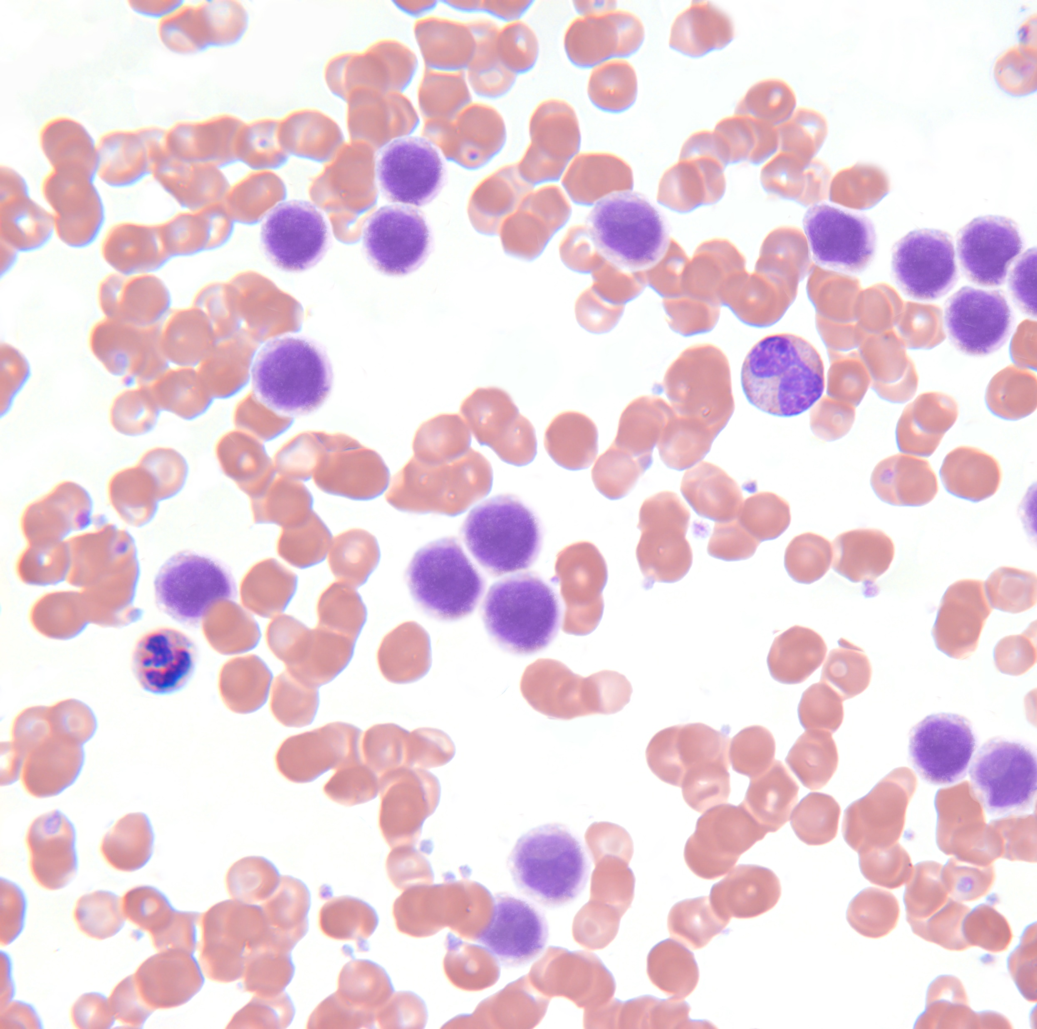
Diagnostic Testing
Using peripheral blood and bone marrow samples, several tests will be used to characterize and classify each patient’s AML.
Tap each technique to learn how they are used in the diagnosis of AML.
Complete blood count (CBC) with differential
Peripheral
blood smear
Bone marrow
aspirate and biopsy
Immunophenotyping
Cytogenetic and molecular genetics
In a peripheral blood smear, a sample of blood is looked at under a microscope. This will determine cell counts, specifically the percentage of myeloid blasts in the blood and the cellular morphology of those blasts. Common morphologic features include large nuclei and Auer rods (pink/red rod-like granular structures in the cytoplasm).
Myeloid blast
AML Morphology on Blood Smear
Diagnostic Testing Deep Dive

Slide 45
Diagnostic Testing
Using peripheral blood and bone marrow samples, several tests will be used to characterize and classify each patient’s AML.
Tap each technique to learn how they are used in the diagnosis of AML.
Complete blood count (CBC) with differential
Peripheral
blood smear
Bone marrow
aspirate and biopsy
Immunophenotyping
Cytogenetic and molecular genetics
Bone marrow aspiration and biopsy are key components to the diagnosis of AML as the samples are used to determine the blast count, cell origin, and the presence of cytogenetic and molecular genetic abnormalities in the DNA of the blasts.
These tests are the only way to determine the status of a patient’s AML. They are repeated often during the treatment of AML—before a patient receives treatment, during treatment, and after treatment to monitor if the patient’s leukemia is responding.
Diagnostic Testing Deep Dive

Slide 46
Diagnostic Testing
Using peripheral blood and bone marrow samples, several tests will be used to characterize and classify each patient’s AML.
Tap each technique to learn how they are used in the diagnosis of AML.
Complete blood count (CBC) with differential
Peripheral
blood smear
Bone marrow
aspirate and biopsy
Immunophenotyping
Cytogenetic and molecular genetics
Immunophenotyping of the peripheral blood and bone marrow aspirate is performed to determine the myeloid lineage of the blasts, which can be helpful in AML subtype classification. Flow cytometry is used to identify characteristic expression patterns of surface antigens on the blasts. The specific patterns differ among AML subtypes, but most cases express the surface antigens CD34, HLA-DR, CD117, CD13, and CD33.
Diagnostic Testing Deep Dive

Slide 47
Diagnostic Testing
Using peripheral blood and bone marrow samples, several tests will be used to characterize and classify each patient’s AML.
Tap each technique to learn how they are used in the diagnosis of AML.
Complete blood count (CBC) with differential
Peripheral
blood smear
Bone marrow
aspirate and biopsy
Immunophenotyping
Cytogenetic and molecular genetics
The presence of cytogenetic and molecular genetic abnormalities can help identify certain types of AML and can be important in determining a patient’s prognosis and treatment options. Cytogenetics can be determined using a karyotype test and genetic mutations are identified using fluorescent in situ hybridization (FISH) and polymerase chain reaction (PCR).
Diagnostic Testing Deep Dive

Slide 48
Diagnostic Testing Deep Dive
Bone marrow aspiration and biopsy
Bone marrow samples obtained from the aspirate and biopsy are typically obtained at the same time and are usually taken from the back of the hip bone. Patients are usually awake for the procedure, which takes approximately 10 minutes to complete. For a bone marrow aspiration, a thin, hollow needle is inserted into the bone and a syringe is used to draw out a small amount of liquid bone marrow. Although anesthetic is used, most patients still have some brief pain when the marrow is removed. A bone marrow biopsy is usually done just after the aspiration. A small piece of bone and marrow is removed with a slightly larger needle that is pushed down into the bone, which may also cause some brief pain.
Cytogenetic and molecular genetics
Cytogenetics can be determined using a karyotype test, where cells are looked at under a microscope to visualize large-scale chromosomal abnormalities. It usually takes about 2–3 weeks to receive the results of this test. Since AML is a rapidly growing disease, delaying initial therapy to wait for these results may benefit some patients, but harm others.
Fluorescent in situ hybridization (FISH) and polymerase chain reaction (PCR) are more sensitive tests that can be used to identify known genetic mutations that are important in AML, such as FLT3, NPM1, KIT, CEBPA, IDH1/2, TP53, and RUNX1.

Slide 49
Chapter Summary
The signs and symptoms of AML can be associated with other diseases. Most often, they are due to the loss of functioning, healthy blood cells, which causes anemia, thrombocytopenia, and neutropenia
A diagnosis of AML requires ≥20% blasts to be found in the bone marrow or peripheral blood, or requires specific cytogenetic abnormalities, regardless of blast count
While evaluating a patient’s blood and bone marrow, it is important to determine their cytogenetic and mutational status as both can affect the patient’s prognosis and future treatment options
Tap here to check in with Rodney
Notes:
Narration:
In this chapter we reviewed the signs and symptoms of AML and the techniques used to diagnosis the disease.
Review the key concepts we discussed from Chapter 3 here and tap the button to see how Rodney is doing.

Slide 50
Rodney’s Initial Symptoms
Like many other AML patients, I began to feel a general unwellness right before I was diagnosed. I scheduled an appointment with my primary care physician to discuss my symptoms—fatigue and difficulty catching my breath. He referred me to a hematologist/oncologist after my CBC with differential results showed that I had anemia and neutropenia.
After my bone marrow biopsy, the hematologist/oncologist had me come in for a follow-up appointment and that’s when I was diagnosed with AML.

Slide 51
From the word bank below, drag and drop the signs and symptoms of AML into the box.
Signs and Symptoms of AML
Fatigue
Loss of appetite
Weight loss
Fever
Night sweats
Blurred vision
Enlarged lymph nodes
Skin lesions
Word Bank
Liver enlargement
Notes:
Remediation after answering:
Correct/incorrect. Fatigue, loss of appetite, weight loss, fever, and night sweats are all signs and symptoms of AML.

Slide 52
Complete the sentence using the drop down boxes:
A diagnosis of AML can be confirmed when ________________ ___________________ blasts are found in the peripheral blood or bone marrow.
≥
20%
≥
20%
≤
10%
Notes:
Remediation after answering:
Correct/incorrect. A diagnosis of AML can be confirmed when ≥20% blasts are found in the peripheral blood or bone marrow.

Slide 53
Which tests can be used to help diagnose AML?
A. CBC with differential, peripheral blood smear, bone marrow aspirate and biopsy, immunophenotyping, cytogenetic and molecular genetic testing
B. CT Scan, peripheral blood smear, tissue biopsy, FISH
C. Peripheral blood smear, skin prick test, cytogenetic and molecular genetic testing
D. CBC with differential, CT scan, bone marrow aspirate and biopsy, ultrasound
E. None of the above
Notes:
Remediation after answering:
Correct/incorrect. A CBC with differential, peripheral blood smear, bone marrow aspirate and biopsy, immunophenotyping, and cytogenetic and molecular genetic testing can all be used to help diagnose AML.

Slide 54

Chapter 4 AML Classification and Prognosis
The classification of AML is used to define the AML subtype based on immunophenotype, genetics, and clinical features. AML subtypes can influence a patient’s prognosis and treatment options.
After completing this chapter, you will be able to:
Define the staging systems used for AML
Identify the prognostic markers for AML
AML Classification Systems
AML Prognostic Factors
Notes:
Narration:
The classification of AML is used to define the AML subtype based on immunophenotype, and genetic and clinical features. AML subtypes can influence a patient’s prognosis and treatment options.
Before we continue, take a moment to review the key learning objectives for this chapter.

Slide 55
AML Subtype Classification
For most cancers, determining the stage or extent of the cancer based on tumor size is very important. However, AML does not usually form tumors. It is generally widespread throughout the peripheral blood and bone marrow. Therefore, the prognosis and treatment course for an AML patient depends on other information such as the subtype. Two main systems are used to classify AML into subtypes—the French-American-British (FAB) classification and the World Health Organization (WHO) classification.
FAB Classification
WHO Classification
In the 1970s, a group of French, American, and British leukemia experts divided AML into subtypes (M0–M7) based on the type of cell the leukemia develops from and how mature the blast cells are
This was largely based on the morphology of the leukemia cells observed using a blood smear
The FAB classification system can be useful, but it doesn’t include many of the factors that are known to affect the prognosis of AML patients
The newer WHO classification system (2016) is commonly used for AML and divides patients into 6 groups based on the morphology, immunophenotype, genetics, and clinical features of their disease
FAB Classification Subtypes
WHO Classification Subtypes
Look AHEAD
The next module, Treatment of AML, provides an overview on how treatment is determined, including the role of subtype.
Notes:
Narration:
The prognosis and treatment course for AML patients depends on the subtype of AML, which can be classified using the French-American-British Classification or the newer World Health Organization Classification.
The WHO Classification is more commonly used for AML and divides patients based on the morphology, immunophenotype, and genetic and clinical features of their disease.
Tap the buttons to learn more about the specific subtypes within each classification system.

Slide 56
FAB Classification Subtypes
The FAB Classification divides AML subtypes based on the type of immature blood cell the blast originates from—either a WBC, RBC, or platelet.
FAB Classification
Start in immature WBCs
M0 | Undifferentiated acute myeloblastic leukemia (<5% of total AML)
M1 | Acute myeloblastic leukemia with minimal maturation (5–10% of total AML)
M2 | Acute myeloblastic leukemia with maturation (10–14% of total AML)
M3 | Acute promyelocytic leukemia (APL, up to 13% of newly diagnosed AML)
M4 | Acute myelomonocytic leukemia (AMML, 5–10% of total AML)
M5 | Acute monocytic leukemia (5–10% of total AML)
Starts in immature RBCs
M6 | Acute erythroid leukemia (<5% of total AML)
Starts in immature platelets
M7 | Acute megakaryoblastic leukemia (<1% of total AML)
Hematopoietic stem cell
Common myeloid progenitor
Megakaryoblast
Proerythroblast
Monoblast
Myeloblast
Immature cells that could become leukemic blasts
Notes:
Narration:
The FAB classification divides AML subtypes based on the type of immature blood cell the blast originates from.

Slide 57
WHO Classification Subtypes
Advances in the identification of unique genetic abnormalities associated with myeloid hematologic malignancies led to the development of the current WHO Classification system for AML. This system incorporates new clinical, prognostic, morphologic, immunophenotypic, and genetic data that can impact a patient’s prognosis and treatment selection.
Use the scroll bar to review the WHO Classification system for AML.
WHO Classification
AML with recurrent genetic abnormalities: contains the most common genetic abnormalities of prognostic significance and accounts for 20–30% of AML cases
AML with t(8;21)(q22;q22.1); RUNX1-RUNX1T1 AML with inv(16)(p13.1q22) or t(16;16)(p13.1;q22); CBFB-MYH11 APL with PML-RARA AML with t(9;11)(p21.3;q23.3); MLLT3-KMT2A AML with t(6;9)(p23;q34.1); DEK-NUP214 AML with inv(3)(q21.3q26.2) or t(3;3)(q21.3;q26.2); GATA2,MECOM(EVI1) | AML with inv(3)(q21.3q26.2) or t(3;3)(q21.3;q26.2); GATA2,MECOM(EVI1) AML (megakaryoblastic) with t(1;22)(p13.3;q13.3); RBM15-MKL1 AML with BCR-ABL1 AML with mutated NPM1 AML with biallelic mutations of CEBPA AML with mutated RUNX1
AML with myelodysplasia-related changes: cases that fit the diagnosis of AML, without a history of prior cytotoxic therapy for an unrelated disease, with 1 or more characteristics associated with myelodysplasia
Therapy-related myeloid neoplasm: cases that fit the diagnosis of AML in a patient with prior exposure to cytotoxic agents and/or ionizing radiation
Notes:
Narration:
The WHO classification incorporates new clinical, prognostic, morphologic, immunophenotypic, and genetic data that can impact a patient’s prognosis and treatment selection.
Use the scroll bar to review the WHO classification system for AML.

Slide 58
WHO Classification Subtypes
Advances in the identification of unique genetic abnormalities associated with myeloid hematologic malignancies led to the development of the current WHO Classification system for AML. This system incorporates new clinical, prognostic, morphologic, immunophenotypic, and genetic data that can impact a patient’s prognosis and treatment selection.
Use the scroll bar to review the WHO Classification system for AML.
WHO Classification
AML, not otherwise specified (NOS): cases that do not meet the criteria for the categories described above
AML with minimal differentiation (FAB M0) AML without maturation (FAB M1) AML with maturation (FAB M2) Acute myelomonocytic leukemia (FAB M4) Acute monoblastic/monocytic leukemia (FAB M5) | Pure erythroid leukemia (FAB M6) Acute megakaryoblastic leukemia (FAB M7) Acute basophilic leukemia Acute panmyelosis with myelofibrosis
Myeloid sarcoma: cases that present with a mass outside the bone marrow consisting of myeloid blasts with or without maturation, also known as granulocytic sarcoma or chloroma
Myeloid proliferations related to Down syndrome: cases of AML that develop in the presence of Down syndrome (trisomy 21)

Slide 59
Prognostic Risk Stratification
Genetic abnormalities are powerful prognostic factors in AML, accounting for ~66% of the variation in patient survival. Therefore, molecular and genetic risk stratification is key to predicting a patient’s outcome and can be used to guide treatment decisions. The European LeukemiaNet (ELN) provides recommendations for AML risk stratification by genetics, which can be seen in the table below.
2017 ELN Risk Stratification by Genetics in AML
 | Genetic Abnormality | Molecular Abnormality
Low Risk favorable | t(8;21)(q22;q22.1); RUNX1-RUNX1T1 inv(16)(p13.1q22) or t(16;16)(p13.1;q22); CBFB-MYH11 | Mutated NPM1 without FLT3-ITD or with FLT3-ITD^{low} Biallelic mutated CEBPA
Intermediate Risk | t(9;11)(p21.3;q23.3); MLLT3-KMT2A Cytogenetic abnormalities not classified as favorable or adverse | Mutated NPM1 and FLT3-ITD^{high} Wild-type NPM1 without FLT3-ITD or with FLT3-ITD^{low} (without adverse-risk genetic lesions)
High Risk adverse | t(6;9)(p23;q34.1); DEK-NUP214 t(v;11q23.3); KMT2A rearranged t(9;22)(q34.1;q11.2); BCR-ABL1 inv(3)(q21.3q26.2) or t(3;3)(q21.3;q26.2); GATA2,MECOM(EVI1) –5 or del(5q); –7; –17/abn(17p) Complex karyotype, monosomal karyotype | Wild-type NPM1 and FLT3-ITD^{high} Mutated RUNX1 Mutated ASXL1 Mutated TP53
Look BACK
Remember from Chapter 2 the various chromosomal and cytogenetic abnormalities that are associated with AML blasts.
Notes:
Narration:
Genetic abnormalities are strong prognostic factors in AML. Therefore, molecular and genetic risk stratification is important to predicting a patient’s outcome and can be used to guide treatment decisions.
Review the table to learn more about the European LeukemiaNet recommendations for AML risk stratification.

Slide 60
AML Prognosis
The subtype of AML can be important in helping to determine a patient’s prognosis. However, other factors can also affect why some patients with AML have a better prognosis than others. Prognostic factors in AML can be broken into 2 categories—patient-related factors and AML-related genetic factors.
Tap each number on the right to reveal the adverse, patient-related prognostic factors for AML.
Adverse Prognostic Factors
1
Increased age (≥60 years old)
2
3
4
5
6
7
Tap here to check in with Rodney
Notes:
Narration:
The subtype of AML can help to determine a patient’s prognosis, however patient-related factors can also affect why some patients have a better outcome than others.
Tap each number to reveal the adverse, patient-related prognostic factors for AML and the button at the bottom to see how Rodney is doing.

Slide 61
AML Prognosis
The subtype of AML can be important in helping to determine a patient’s prognosis. However, other factors can also affect why some patients with AML have a better prognosis than others. Prognostic factors in AML can be broken into 2 categories—patient-related factors and AML-related genetic factors.
Tap each number on the right to reveal the adverse, patient-related prognostic factors for AML.
Adverse Prognostic Factors
1
Increased age (≥60 years old)
2
Poor performance status/presence of comorbidities (eg, heart failure or renal insufficiency)
3
History of prior blood disorder, such as myelodysplastic syndrome
4
History of prior exposure to cytotoxic agents or radiation therapy
5
Central nervous system involvement
6
High WBC count (>100,000 cells/μL)
7
Relapsed or refractory AML
Tap here to check in with Rodney

Slide 62
Rodney’s Decision
After learning of my diagnosis, I was told AML is a very aggressive disease, and that I would need to start thinking about treatment options right away. Upon hearing this, I was immediately overwhelmed with my diagnosis and struggled with my doctor’s recommendation to start treatment right away—I was not prepared to make this decision!
I went home and started reading online about AML and learned that if left untreated, AML usually gets worse quickly. The majority of older patients, such as myself, will die within a year of diagnosis. After researching AML and talking with my supportive family, I’ve decided to start treatment as soon as possible.

Slide 63
Chapter Summary
AML was originally classified using the FAB system but has transitioned to the WHO system, which has refined prognostic subgroups based on current AML morphology, immunophenotype, genetics, and clinical features that help define treatment choices
Genetic abnormalities are powerful prognostic factors in AML. It is important to stratify patients based on their mutational status as this will influence their prognosis and treatment options
The prognosis of AML patients is dependent on AML-related genetic factors and patient-related factors, such as age and performance status
Notes:
Narration:
The classification of AML determines the prognostic subgroup based on the morphology, immunophenotype, genetics, and clinical features of the leukemic blasts.
Genetic abnormalities are powerful prognostic factors in AML and may influence treatment options.
Review the key concepts we discussed from Chapter 4 here.

Slide 64
This staging system divides AML into 6 categories based on morphology, immunophenotype, genetics, and clinical features of the patient’s disease.
WHO Classification
or
FAB Classification
Notes:
Remediation after answering:
Correct/incorrect. The WHO Classification divides AML into 6 categories based on morphology, immunophenotype, genetics, and clinical features of the patient’s disease.

Slide 65
From the word bank below, drag and drop the patient-related adverse prognostic factors for AML into the box.
Adverse Prognostic Factors
Increased age
History of prior blood disorder
History of prior exposure to chemotherapy or radiation therapy
Poor performance status
Mutated NPM1
Young age
Word Bank
Increased bilirubin
Low WBC count
Notes:
Remediation after answering:
Correct/incorrect. Increased age, history of prior blood disorder, history of prior exposure to chemotherapy or radiation therapy, and poor performance status are all patient-related adverse prognostic factors.

Slide 66
Module Summary
Acute myeloid leukemia is a rapidly growing cancer that begins in the bone marrow and involves immature myeloid cells. AML is a disease that largely affects older adults, with a median age at diagnosis of 68 years. Older patients tend to have a worse outcome as they usually cannot tolerate the intensive chemotherapy needed for AML treatment.
AML develops due to genetic mutations in the DNA of blasts that affect their growth and differentiation. The immature myeloid blasts quickly accumulate in the blood and bone marrow, causing disease. AML is a heterogeneous disease with numerous chromosomal and genetic mutations that can commonly occur.
Many signs and symptoms of AML occur because there is an overproduction of myeloid blasts and a shortage of healthy blood cells. AML is diagnosed by the presence of ≥20% myeloid blasts in the peripheral blood or bone marrow, or requires specific cytogenetic abnormalities, regardless of blast count.
A patient’s AML subtype is most often determined using the WHO Classification system. The AML subtype and genetic mutational status will help determine the patient’s prognostic risk and can influence treatment options.
Notes:
Narration:
Congratulations, you have completed the AML Disease State Essentials module.
We hope you have found this interactive learning experience informative and helpful in your journey to understand the AML disease state.
For a quick recap of the material covered, review the module summary here.

Slide 67
Glossary
Antigen
Any substance that causes the body to make an immune response against that specific substance.
Clone
A cell that is genetically identical to the original from which it was derived.
Flow cytometry
An experimental technique that analyzes large populations of cells, one cell at a time, by visualizing cell surface markers. It can be used to detect different types of cells in the blood or bone marrow.
Gene
The functional and physical unit of heredity passed from parent to offspring. Genes are pieces of DNA that may encode a protein or functional RNA.
Hematopoiesis
The process by which the various types of blood cells form and develop.
Petechiae
Pinpoint, unraised, round red spots under the skin caused by bleeding.
Pluripotent
Having the ability to mature or develop in many ways.

Slide 68
References
Acute myeloid leukemia Booklet. Leukemia and Lymphoma Society website. https://www.lls.org/resource-center/download-or-order-free-publications. Accessed October 21, 2019.
Acute myeloid leukaemia (AML) Subtypes and Prognostic Factors. American Cancer Society website. https://www.cancer.org/cancer/acute-myeloid-leukemia/detection-diagnosis-staging/how-classified.html. Accessed October 15, 2019.
Antigen. National Cancer Institute website. https://www.cancer.gov/publications/dictionaries/cancer-terms/def/antigen. Accessed January 7, 2020.
Cancer stat facts: Leukemia – Acute Lymphocytic Leukemia (ALL). National Cancer Institute website. https://seer.cancer.gov/statfacts/html/alyl.html. Accessed August 22, 2019
Cancer Stat Facts: Leukemia – Acute Myeloid Leukemia (AML). National Cancer Institute website. https://seer.cancer.gov/statfacts/html/amyl.html. Accessed October 17, 2019.
Cancer stat facts: Leukemia – Chronic Lymphocytic Leukemia (CLL). National Cancer Institute website. https://seer.cancer.gov/statfacts/html/clyl.html. Updated April 2019. Accessed August 22, 2019.
Cancer stat facts: Leukemia – Chronic Myeloid Leukemia (CML). National Cancer Institute website. https://seer.cancer.gov/statfacts/html/cmyl.html. Accessed August 22, 2019.
Cancer stat facts: Leukemia. National Cancer Institute website. https://seer.cancer.gov/statfacts/html/leuks.html. Accessed August 22, 2019.
Clone. Dictionary.com website. https://www.dictionary.com/browse/clonal. Accessed January 16, 2020.
Development of Blood. Lumen Learning website. https://courses.lumenlearning.com/boundless-ap/chapter/development-of-blood. Accessed November 4, 2019.
Dohner H, Estey E, Grimwade D et al. Diagnosis and management of AML in adults: 2017 ELN recommendations from an international expert panel. Blood. 2017;129(4):424–447.
Global Burden of Disease Cancer Collaboration. Global, Regional, and National Cancer Incidence, Mortality, Years of Life Lost, Years Lived With Disability, and Disability-Adjusted Life-Years for 29 Cancer Groups, 1990 to 2017: A Systematic Analysis for the Global Burden of Disease Study. JAMA Oncol. 2019.
Hematopoiesis. NCI Dictionary website. https://www.cancer.gov/publications/dictionaries/cancer-terms/def/hematopoiesis. Accessed January 16, 2020.
Kayser S, Dohner K, Krauter J et al. The impact of therapy-related acute myeloid leukemia (AML) on outcome in 2853 adult patients with newly diagnosed AML. Blood. 2011;117(7):2137–2145.
Larson RA. Acute myeloid leukemia: Treatment and outcomes in older adults. UpToDate website. https://www.uptodate.com/contents/acute-myeloid-leukemia- treatment-and-outcomes-in-older-adults. Accessed October 15, 2019.
NCCN Guidelines: Acute Myeloid Leukemia Version 2.2020—September 3, 2019. NCCN Website. https://www.nccn.org/professionals/physician_gls/pdf/aml.pdf. Accessed October 15, 2019.
Petechiae. NCI Dictionary website. https://www.cancer.gov/publications/dictionaries/cancer-terms/def/petechiae. Accessed December 31, 2019.
Pluripotent. NCI Dictionary website. https://www.cancer.gov/publications/dictionaries/cancer-terms/def/pluripotent. Accessed December 31, 2019.

Slide 69
References
Schiffer CA. Prognosis of acute myeloid leukemia. UpToDate website. https://www.uptodate.com/contents/prognosis-of-acute-myeloid-leukemia. Accessed October 15, 2019.
Schiffer CA, Gurbaxani S. Classification of acute myeloid leukemia. UpToDate website. https://www.uptodate.com/contents/classification-of-acute-myeloid-leukemia. Accessed October 9, 2019.
Schiffer CA, Gurbaxani S. Clinical manifestations, pathologic features, and diagnosis of acute myeloid leukemia. UpToDate website. https://www.uptodate.com/contents/clinical-manifestations-pathologic-features-and-diagnosis-of-acute-myeloid-leukemia. Accessed October 10, 2019.
Signs and Symptoms of Acute Myeloid Leukemia (AML). American Cancer Society website. https://www.cancer.org/cancer/acute-myeloid-leukemia/detection-diagnosis-staging/signs-symptoms.html. Accessed October 15, 2019.
Sieff CA. Overview of hematopoietic stem cells. UpToDate website. https://www.uptodate.com/contents/overview-of-hematopoietic-stem-cells. Accessed October 25, 2019.
Stock W, Thirman MJ. Molecular genetics of acute myeloid leukemia. UpToDate website. https://www.uptodate.com/contents/molecular-genetics-of-acute-myeloid-leukemia. Accessed November 12, 2019.
Stock W, Thirman MJ. Pathogenesis of acute myeloid leukemia. UpToDate website. https://www.uptodate.com/contents/pathogenesis-of-acute-myeloid-leukemia. Accessed November 4, 2019.
Targeted therapy drugs for acute myeloid leukemia (AML). American Cancer Society website. https://www.cancer.org/cancer/acute-myeloid-leukemia/treating/targeted-therapy.html. Accessed October 15, 2019.
Tests for Acute Myeloid Leukemia (AML). American Cancer Society website. https://www.cancer.org/cancer/acute-myeloid-leukemia/detection-diagnosis-staging/how-diagnosed.html. Accessed November 14, 2019.
Typical Treatment of Acute Myeloid Leukemia (Except APL). American Cancer Society website. https://www.cancer.org/cancer/acute-myeloid-leukemia/treating/typical-treatment-of-aml.html. Accessed November 11, 2019.

